Slide 1
3D Printed Head and Body Phantoms
Rose Sheridan and Joanne Stack
Engineering Excellence
September 22, 2021

Slide 2
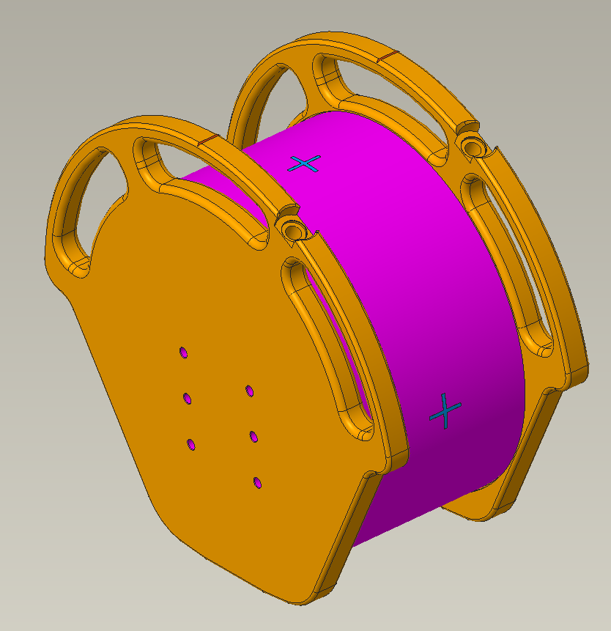
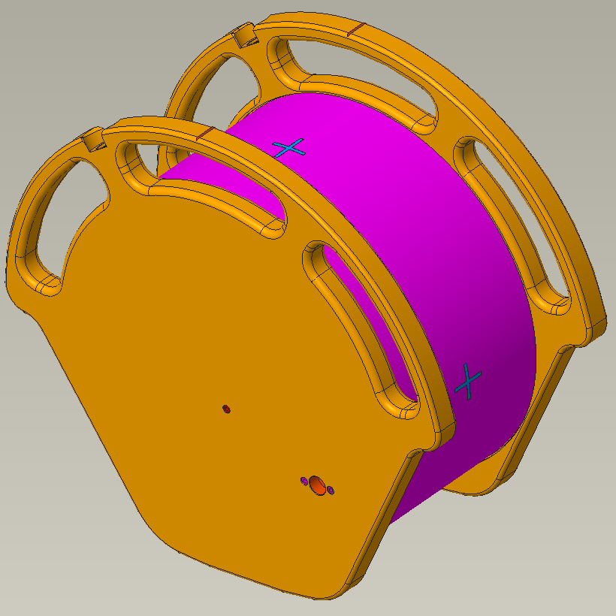


459800442431 Phantom Assembly-Body
“+” symbols can be indented into the printed part
Qty 6, M8x1.25 threaded inserts
M4x0.7 threaded insert
Center portion (magenta) needs to be transparent/translucent acrylic with density 1.14-1.20 g/cm3; Free of scratches and marks; Surface roughness
Printed or assembled parts need to be watertight, no pressure

Slide 3
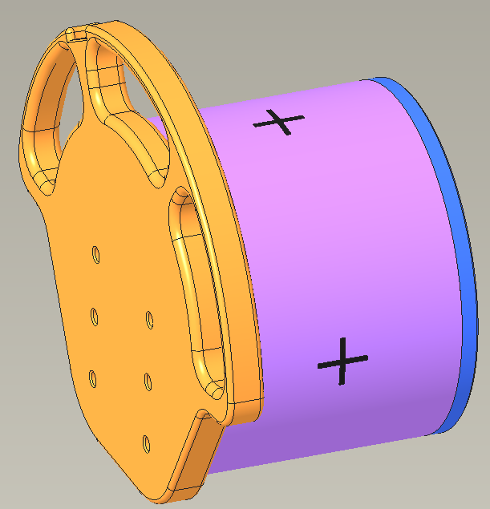
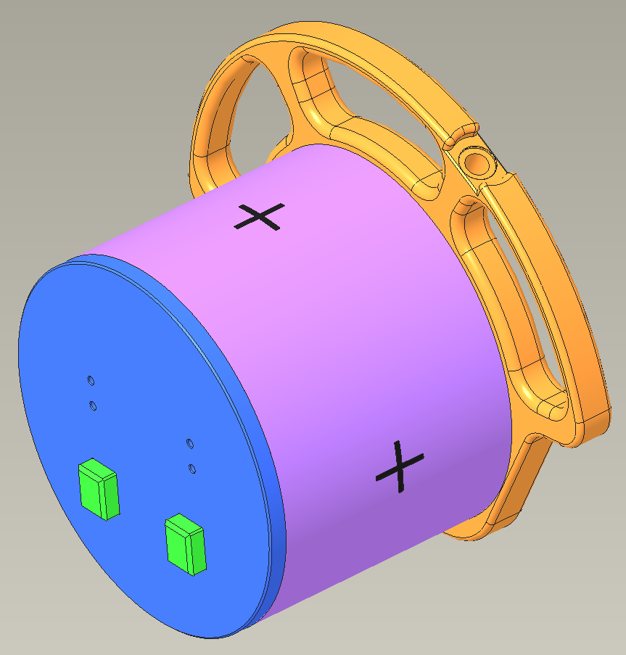
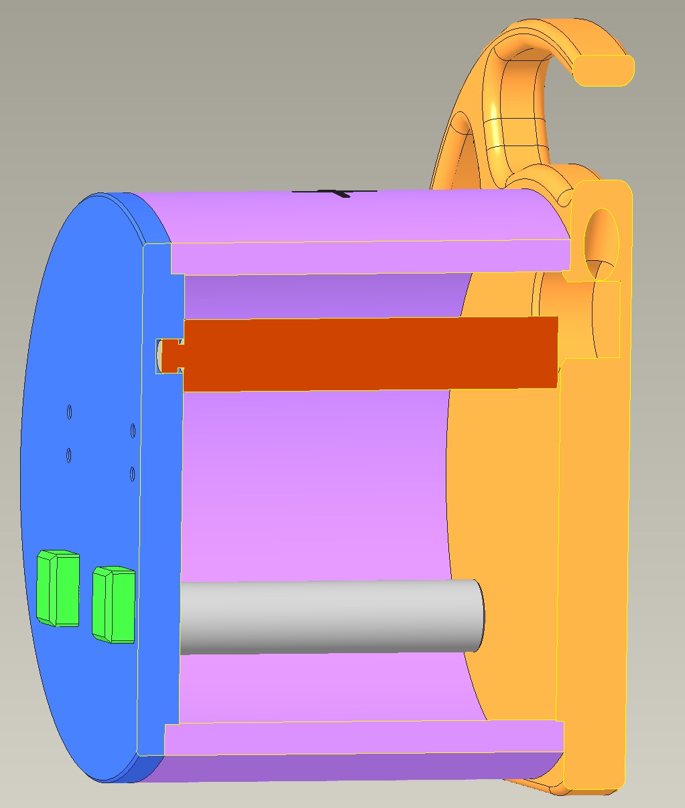
459800443051 Phantom Assembly-Head
Water fill holes
Qty 6, M8x1.25 threaded inserts
“+” symbols can be indented into the printed part
Qty 4, M4x0.7 threaded insert
Center portion (magenta) needs to be transparent/translucent acrylic with density 1.14-1.20 g/cm3; Free of scratches and marks; Surface roughness
Printed or assembled parts need to be watertight, no pressure
Red pin is acrylic with density 1.14-1.20 g/cm3
Gray pin is polyethylene with density 0.92-0.97 g/cm3
Free of scratches and marks; Surface roughness

